Slide 1

C# 6 New Language Features
Steve Michelotti
http://stevemichelotti.com
@smichelotti

Slide 2
C# History
.NET Framework | C# Language
1.0, 1.1 | C# 1.0 (2002)
2.0, 3.0 | C# 2.0 (2005)
3.5 | C# 3.0 (2007)
4.0 | C# 4.0 (2010)
4.5 | C# 5.0 (2012)
4.6 | C# 6.0 (2015)

Slide 3
Agenda
Auto-Property Initializers
Using Static
String Interpolation
Expression Bodied Members
Dictionary Initializers
Add Extensions
Null Conditional Access
nameof Operator
await catch/finally
Exception Filters
Roslyn
Auto-Property Getter Only

Slide 4
C# 6 Features Cut
Primary Constructors
Explicit Constructors
Declaration Expressions
IEnumerable params
Literals and Separators
Notes:
Idempotent – repeated execution of same request will have no affect

Slide 5
Demo

Slide 6
Roslyn
Compiler API
Syntax Trees / Symbols / Flow Analysis / Emit
Enables:
Compiling code on the fly
Analyzing code
Extensions
…and more

Slide 7
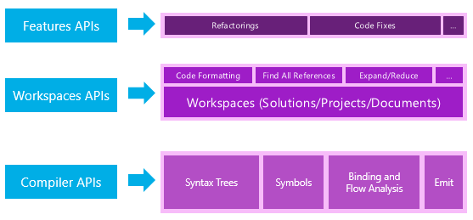
Roslyn

Slide 8
Demo

Slide 9
What We Covered
Auto-Property Initializers
Using Static
String Interpolation
Expression Bodied Members
Dictionary Initializers
Add Extensions
Null Conditional Access
nameof Operator
await catch/finally
Exception Filters
Roslyn
Auto-Property Getter Only

Slide 10
Questions?
Blog: http://stevemichelotti.com
Twitter: @smichelotti (code samples)

